Slide 1
UCB-Biased or Not

Slide 2
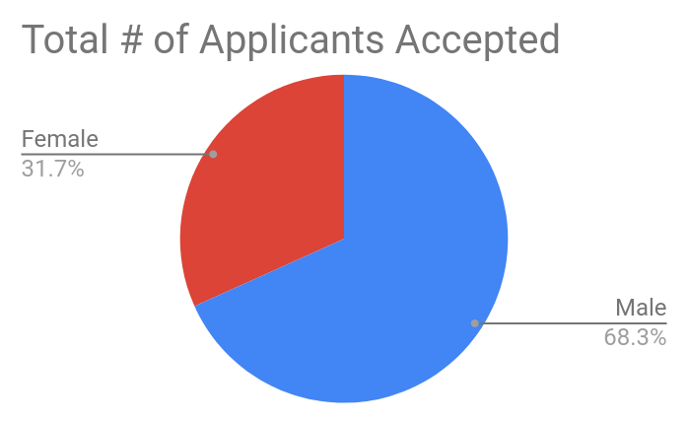
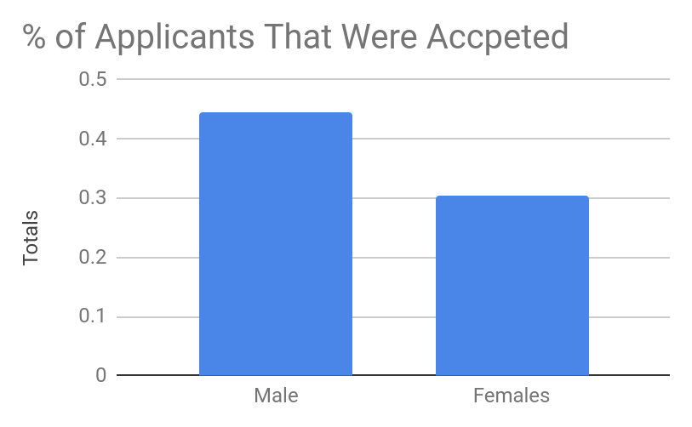
Is UC Berkeley Biased Against Women?
At first it might appear that they are

Slide 3

What To Look For and What Not To
It is important to look at different predictors other than gender when looking at data
Red Herring
Percentage of college class that is male
Percentage of each gender that the college admitted
Things to look for:
Total amount of applicants that applied to the college
Numbers of applicants that applied to each department
Percentage of Men and Women accepted by department

Slide 4
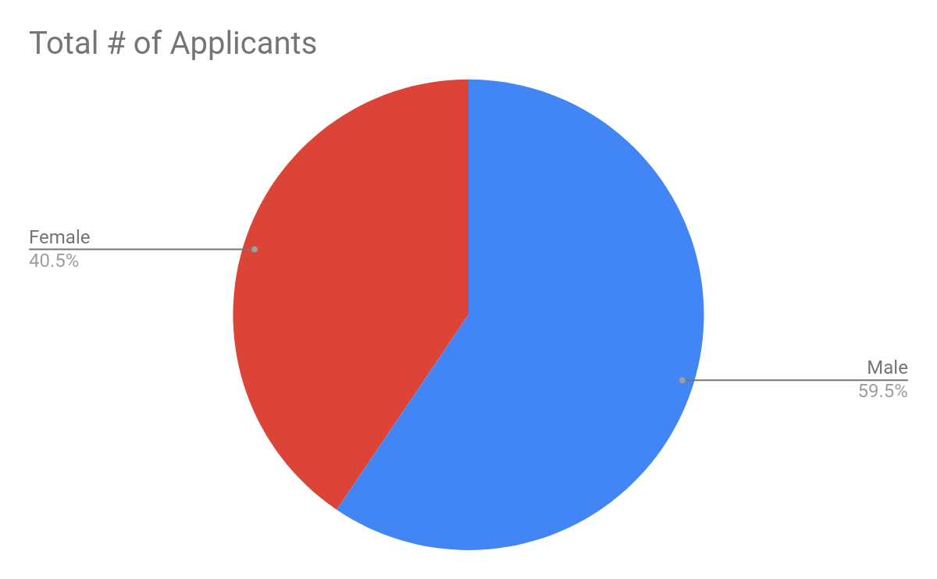
Total Applicants to UC Berkeley
So, already, you can see that there will probably be some non-discriminatory difference in the sexes admitted
8073 Males applied and 5505 females applied

Slide 5
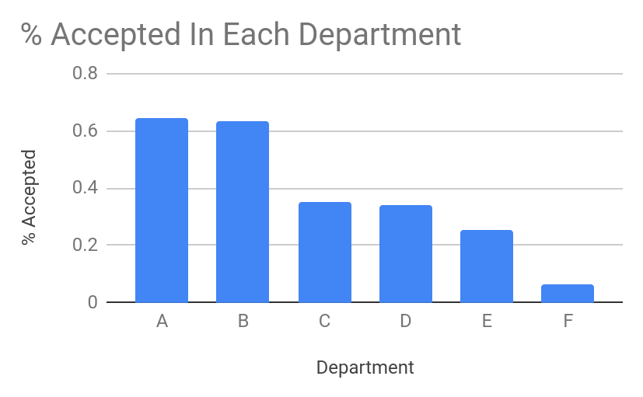
Acceptance Rates by Department
So what will happen if it happened that a lot of males applied to departments A and B or many females applied to departments like E or F

Slide 6
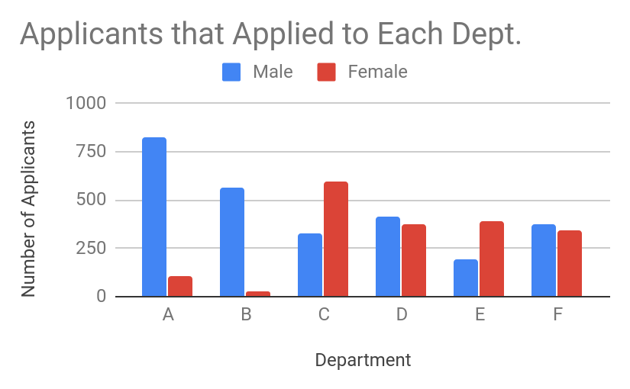
Applications to Each Department by Gender
A lot of males applying for departments A and B, and very few females
Higher % females applying at departments C and E

Slide 7
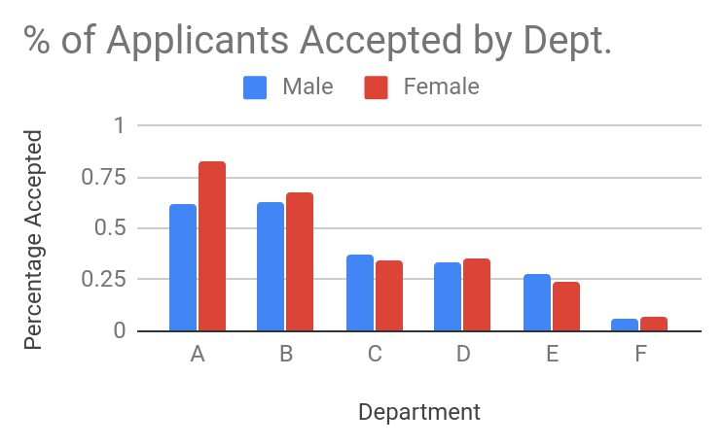
Percentage of Applicants Accepted at Each Dept
This is really our key statistic
It shows what percentage of applicants are accepted at each department

Slide 8

Why is This the Issue?
We can not control how many males and females are applying to college
Nor Can we control which departments they apply to
Suppressed evidence fallacy
If every department is admitting close to an equal percentage of the males and females that apply, that is all we can ask for

